Slide 1
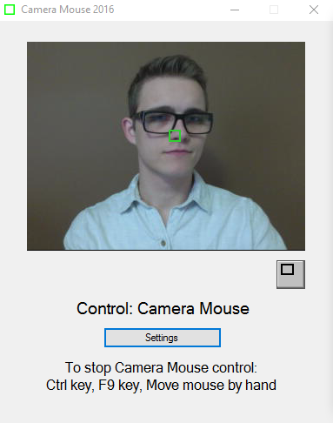
A Comparative Study of Target Assistance
For Pointing with a Camera Mouse
Prasanna Iyengar SoHyun Park Joshua Smith
CS4995 – Interactive Human-Centered Systems Final Project
Camera Mouse
Normal Pointing
With Target Assistance
Introduction
Research Questions
Experiment
The Camera Mouse allows people without a high degree of motor control over their limbs to control a computer cursor by tracking their head movement.
However, pointing with our head can be difficult to control, frustrating and inaccurate.
Does expanding targets allow people to select targets faster and more easily when using the camera mouse?
Are there any important limitations or challenges to using the Camera Mouse to control a mouse cursor?
Within-subject design
12 participants
Telephone keypad target system, Camera Mouse tool developed by Boston College
Independent variable: target assistance
Dependent variables: time, error rate
Results are pending, but you can give us feedback
Solution
Use target assistance in the form of expanding targets to facilitate targeting faster and easier.

